Slide 1
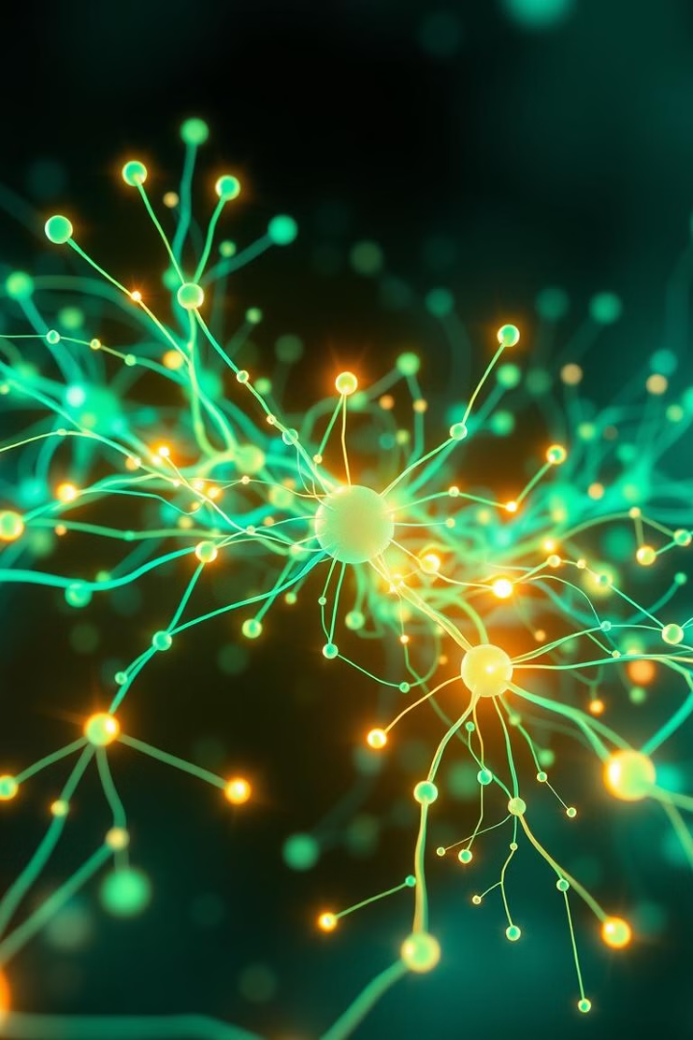
Unlocking the Power of AI: Addressing the Binding Problem in Neural Networks
Today, we'll explore a key challenge in AI: the binding problem, which limits the ability of neural networks to generalize like humans. We'll discuss why this problem matters, explore various research efforts to address it, and delve into the promise of graph neural networks as a powerful tool for achieving human-level generalization in AI.
Authors:
Veronica Baranova
Irek Sakhabutdinov

Slide 2
The Binding Problem: A Fundamental Limitation
Human-Level Generalization
The Binding Problem
Humans excel at generalization, effortlessly applying knowledge to new situations. Current neural networks struggle with this, overfitting to training data and failing to adapt to novel scenarios.
This limitation stems from the binding problem – the challenge of combining information distributed throughout the network. To achieve human-level generalization, neural networks need to dynamically and flexibly bind information.

Slide 3
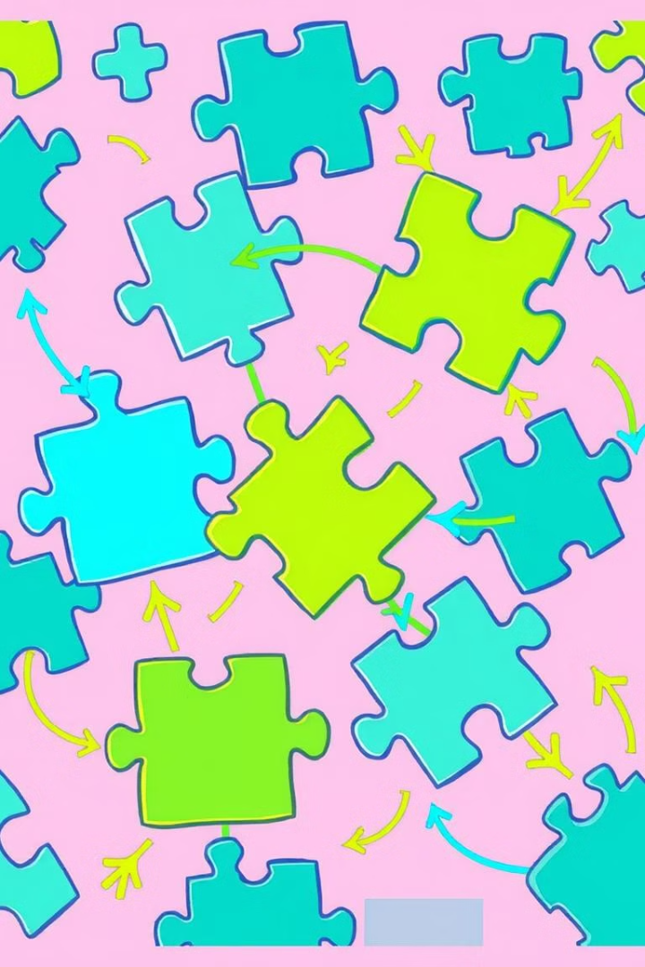
Bridging the Gap: Representations, Segregation, and Composition
Representation
Segregation
Humans perceive objects as distinct entities, comparing their properties. Neural networks need to develop object representations, like symbols, to capture the essence of objects.
Like humans identifying distinct objects in a scene, neural networks need to learn to separate meaningful information from their inputs. This could involve using attention mechanisms.
Composition
Neural networks need to learn to construct models using object representations. This involves learning relations between objects and dynamically binding them to support reasoning.

Slide 4
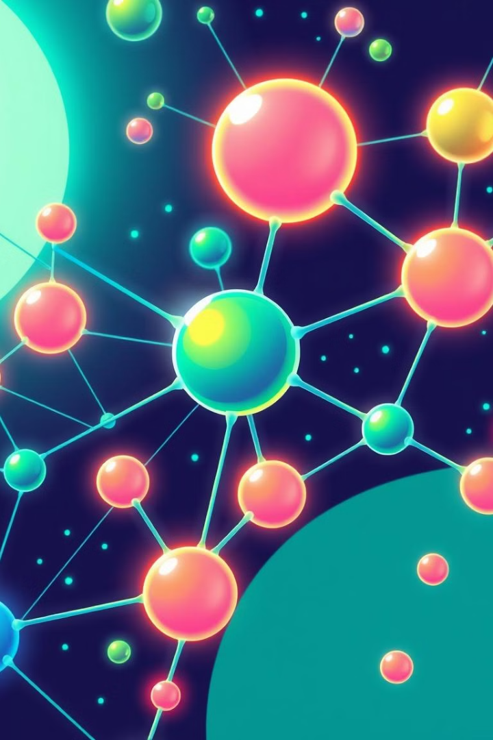
Tackling the Representation Problem
Researchers are exploring various approaches to address the representation problem. One promising avenue is the development of object representations within neural networks. These representations aim to capture the essence of objects as modular building blocks, much like symbols in human language, but retaining the expressive power of neural networks.
These object representations could be based on dedicated slots for storing information about individual objects, or by augmenting features with additional information to group them together. However, slot-based approaches may struggle with objects that are not well-separated or whose size doesn't match the network's receptive field, while augmentation-based approaches can suffer from capacity and ambiguity issues when a feature is active in multiple objects.

Slide 5
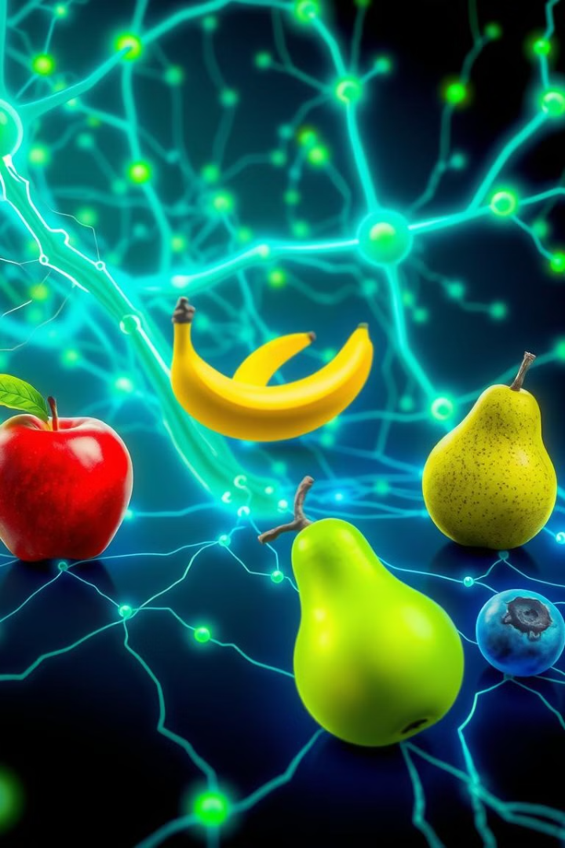
Addressing the Segregation Problem
Another critical aspect is segregation, the process of structuring raw sensory data into meaningful entities. Just as humans perceive a visual scene as a collection of distinct objects, neural networks need to learn to identify and separate meaningful units of information from their inputs.
This could involve leveraging attention mechanisms, where the network selectively focuses on specific regions of the input, similar to how humans move their eyes to attend to different parts of a scene. Methods for segregation include exploiting motion cues, using sequential attention mechanisms, and applying generative approaches to model an image as a mixture of components, each representing an object.

Slide 6
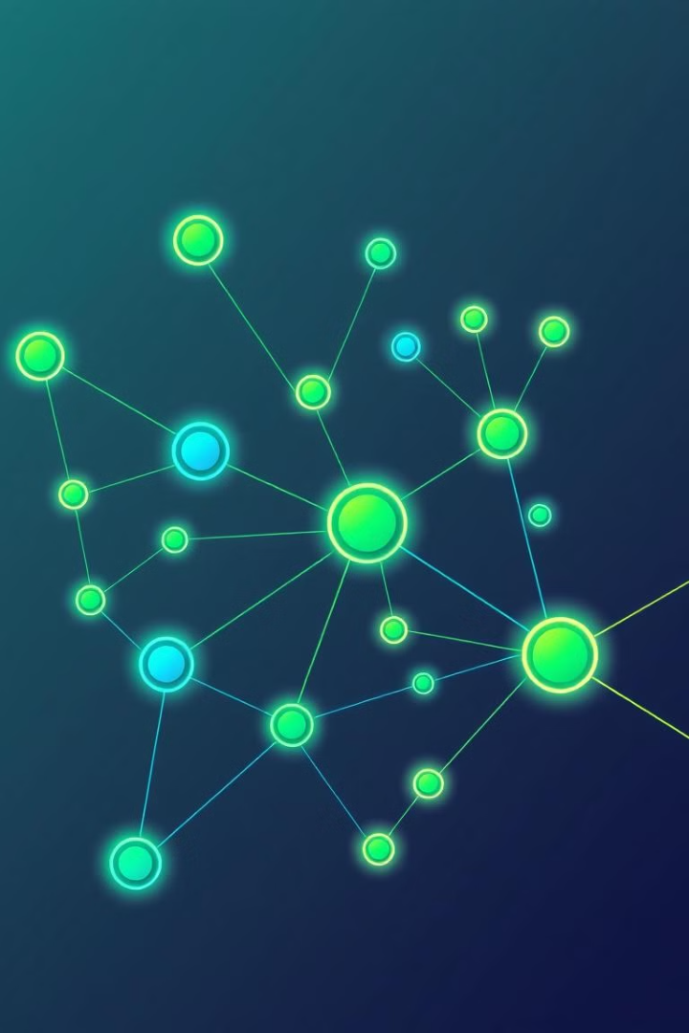
The Composition Problem: Building Complex Models
Finally, composition deals with the challenge of dynamically constructing models using object representations. This involves learning relations between objects and effectively binding them together to form structured representations that support reasoning and inference.
Graph Neural Networks (GNNs), where nodes represent objects and edges represent relations, offer a promising framework for implementing this type of compositional reasoning. GNNs allow the network to dynamically update its understanding of relationships between objects based on new information, enabling more flexible and systematic generalization.

Slide 7
Tapping the Power of Relationships: The Rise of Graph Neural Networks
Traditional neural networks excel at processing data that can be represented as simple sequences or grids, like images or text. But many real-world phenomena are better represented as graphs – intricate networks of interconnected entities. Think of social networks, molecules, transportation systems, or even the complex interplay of ideas in our own minds.
Graph Neural Networks (GNNs) offer a powerful framework for capturing this rich relational information. They do this by representing data as nodes (representing entities) and edges (representing relationships between entities). This structure allows GNNs to learn not only the individual characteristics of each entity but also how these entities interact and influence each other within the overall network.

Slide 8

GNNs: A Powerful Tool for Addressing the Binding Problem
This ability to model relationships makes GNNs particularly well-suited for addressing the binding problem. By explicitly representing relationships as edges, GNNs can learn to dynamically bind information associated with different entities, enabling more flexible and robust generalization.
For instance, a GNN processing a visual scene can represent individual objects as nodes and their spatial relationships as edges. As the network learns, it can update these relationships based on new information, allowing it to adapt to novel scenarios and make inferences about how objects might interact. This dynamic binding process also enables GNNs to learn hierarchical representations, where complex entities are composed of simpler ones.

Slide 9
The Future of AI: Towards Human-Level Generalization
Although GNNs offer a promising framework for addressing the binding problem, future research needs to address the challenge of handling dynamicity in graphs, where nodes and edges change over time. Developing GNNs that can adapt and continuously learn may be crucial for creating truly flexible and intelligent artificial systems.
Nevertheless, this ability to model relationships and hierarchies makes GNNs a powerful tool for tackling complex problems that involve reasoning about interconnected entities. GNNs have the potential to revolutionize fields like drug discovery, social network analysis, and even our understanding of the human brain. By tapping into the power of relationships, GNNs are pushing the boundaries of AI, paving the way for more intelligent and adaptable systems.

Slide 10
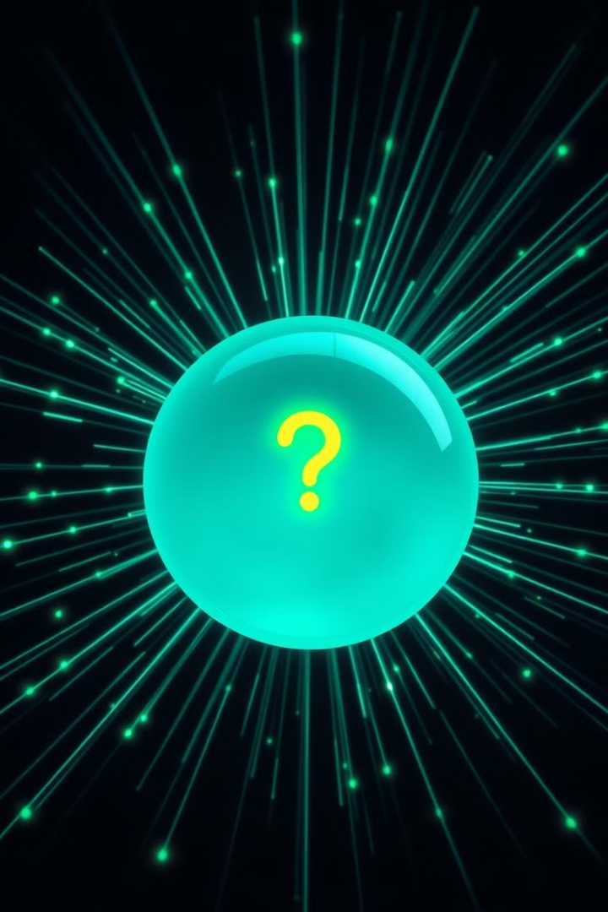
Conclusion: The Binding Problem as a Stepping Stone
The pursuit of human-level generalization in AI is a journey of continuous exploration and innovation. While there are many challenges ahead, the progress made in understanding and addressing the binding problem is a crucial step towards unlocking the true potential of AI. The potential applications of AI that can truly learn and reason like humans are vast and transformative.
The future of AI hinges on cracking the code of generalization. As research in this field continues, the binding problem may become less of a roadblock and more of a stepping stone to a deeper understanding of intelligence itself.

Slide 11
References
Greff, K., Van Steenkiste, S., & Schmidhuber, J. (2020). On the binding problem in artificial neural networks. arXiv preprint arXiv:2012.05208 .
Wu, Z., Pan, S., Chen, F., Long, G., Zhang, C., & Yu, P. S. (2021). A Comprehensive Survey on Graph Neural Networks. IEEE Transaction on Neural Networks and Learning Systems, 32(1), 4–24. https://doi.org/10.1109/TNNLS.2020.2978386 **
**In the BASE article cited as “Zonghan Wu, Shirui Pan, Fengwen Chen, Guodong Long, Chengqi Zhang, and Philip S. Yu. A comprehensive survey on graph neural networks. IEEE Transactions on Neural Networks and Learning Systems, 2020.”

